Slide 1

Clear the Air:
Tobacco and Nicotine Prevention
From the American Heart Association
Locally Sponsored by

Slide 2
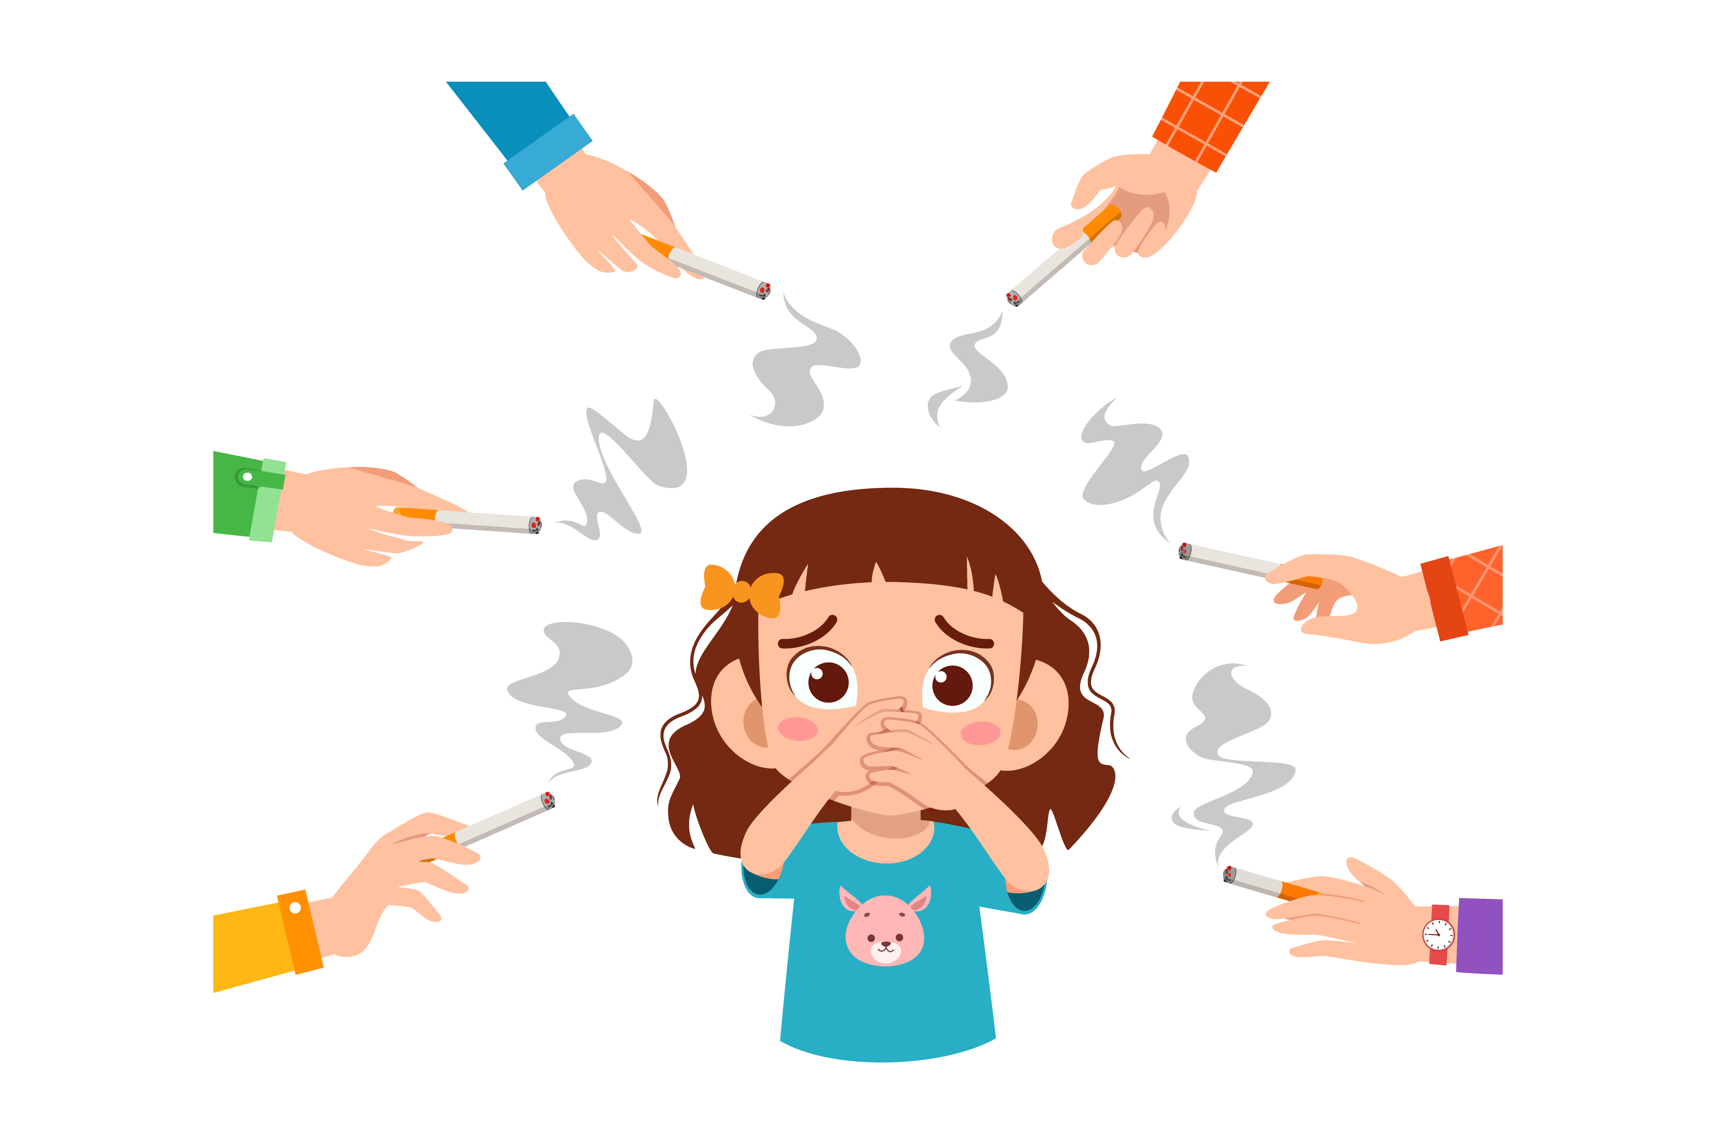
How Does Tobacco/Nicotine Use Affect Your Cardiovascular Health?
Raises blood pressure and heart rate
Causes blood vessels to narrow, increasing the risk of heart attacks
Damages blood vessels, which can increase the risk of having a stroke by causing blood clots
Increases the risks of developing type 2 diabetes, a risk factor for cardiovascular disease - it also makes it harder for people with diabetes to control their blood sugar levels
Notes:
SOURCE
https://www.heart.org/en/healthy-living/healthy-lifestyle/lifes-essential-8/how-to-quit-tobacco-fact-sheet

Slide 3
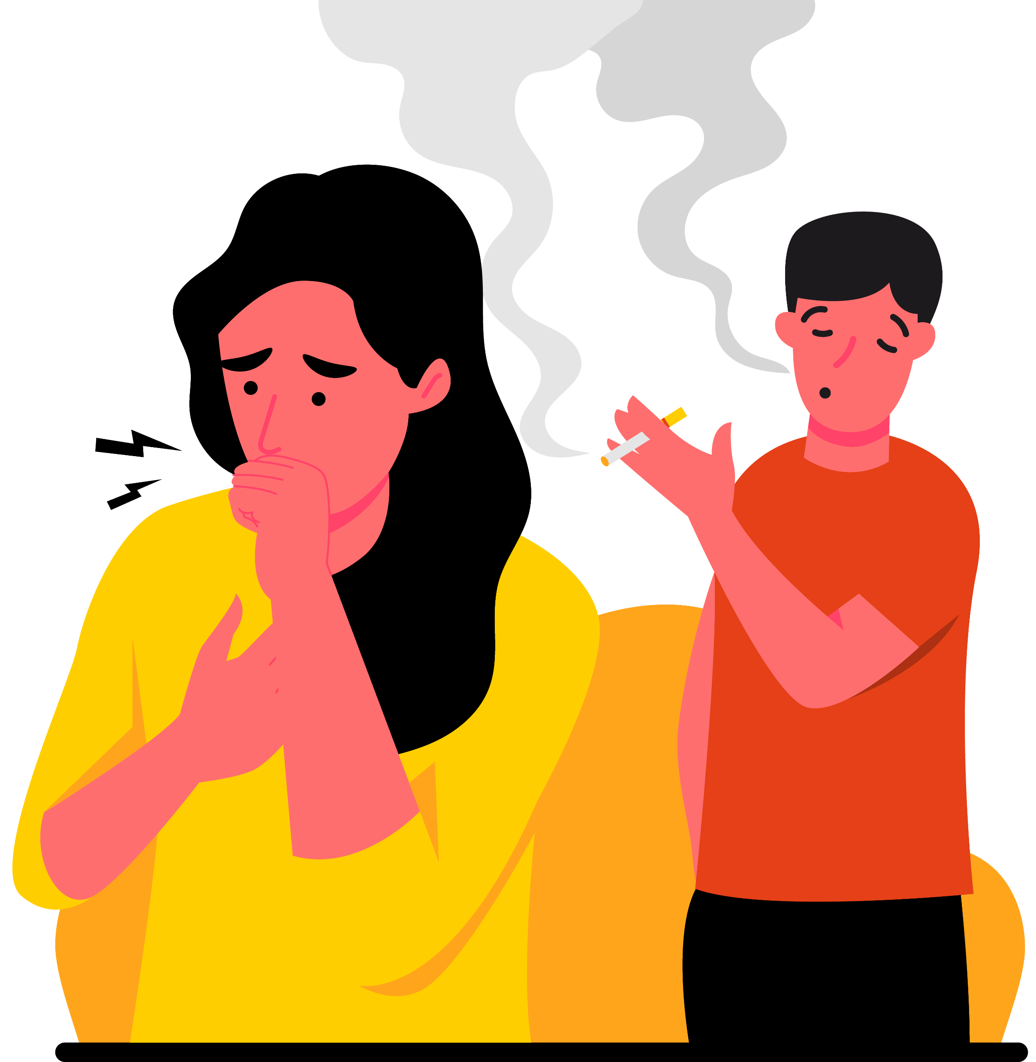
Tobacco/Nicotine Use Can Also Cause…
Cancer. Smoking is the leading cause of lung cancer.
Depression and Anxiety. Nicotine and tobacco can lead to mood swings and heightened anxiety when their effects wear off.
Premature aging. Smoking can cause memory problems and dementia later in life and premature skin damage, like wrinkles.
Notes:
SOURCE
https://www.heart.org/en/healthy-living/healthy-lifestyle/lifes-essential-8/how-to-quit-tobacco-fact-sheet

Slide 4
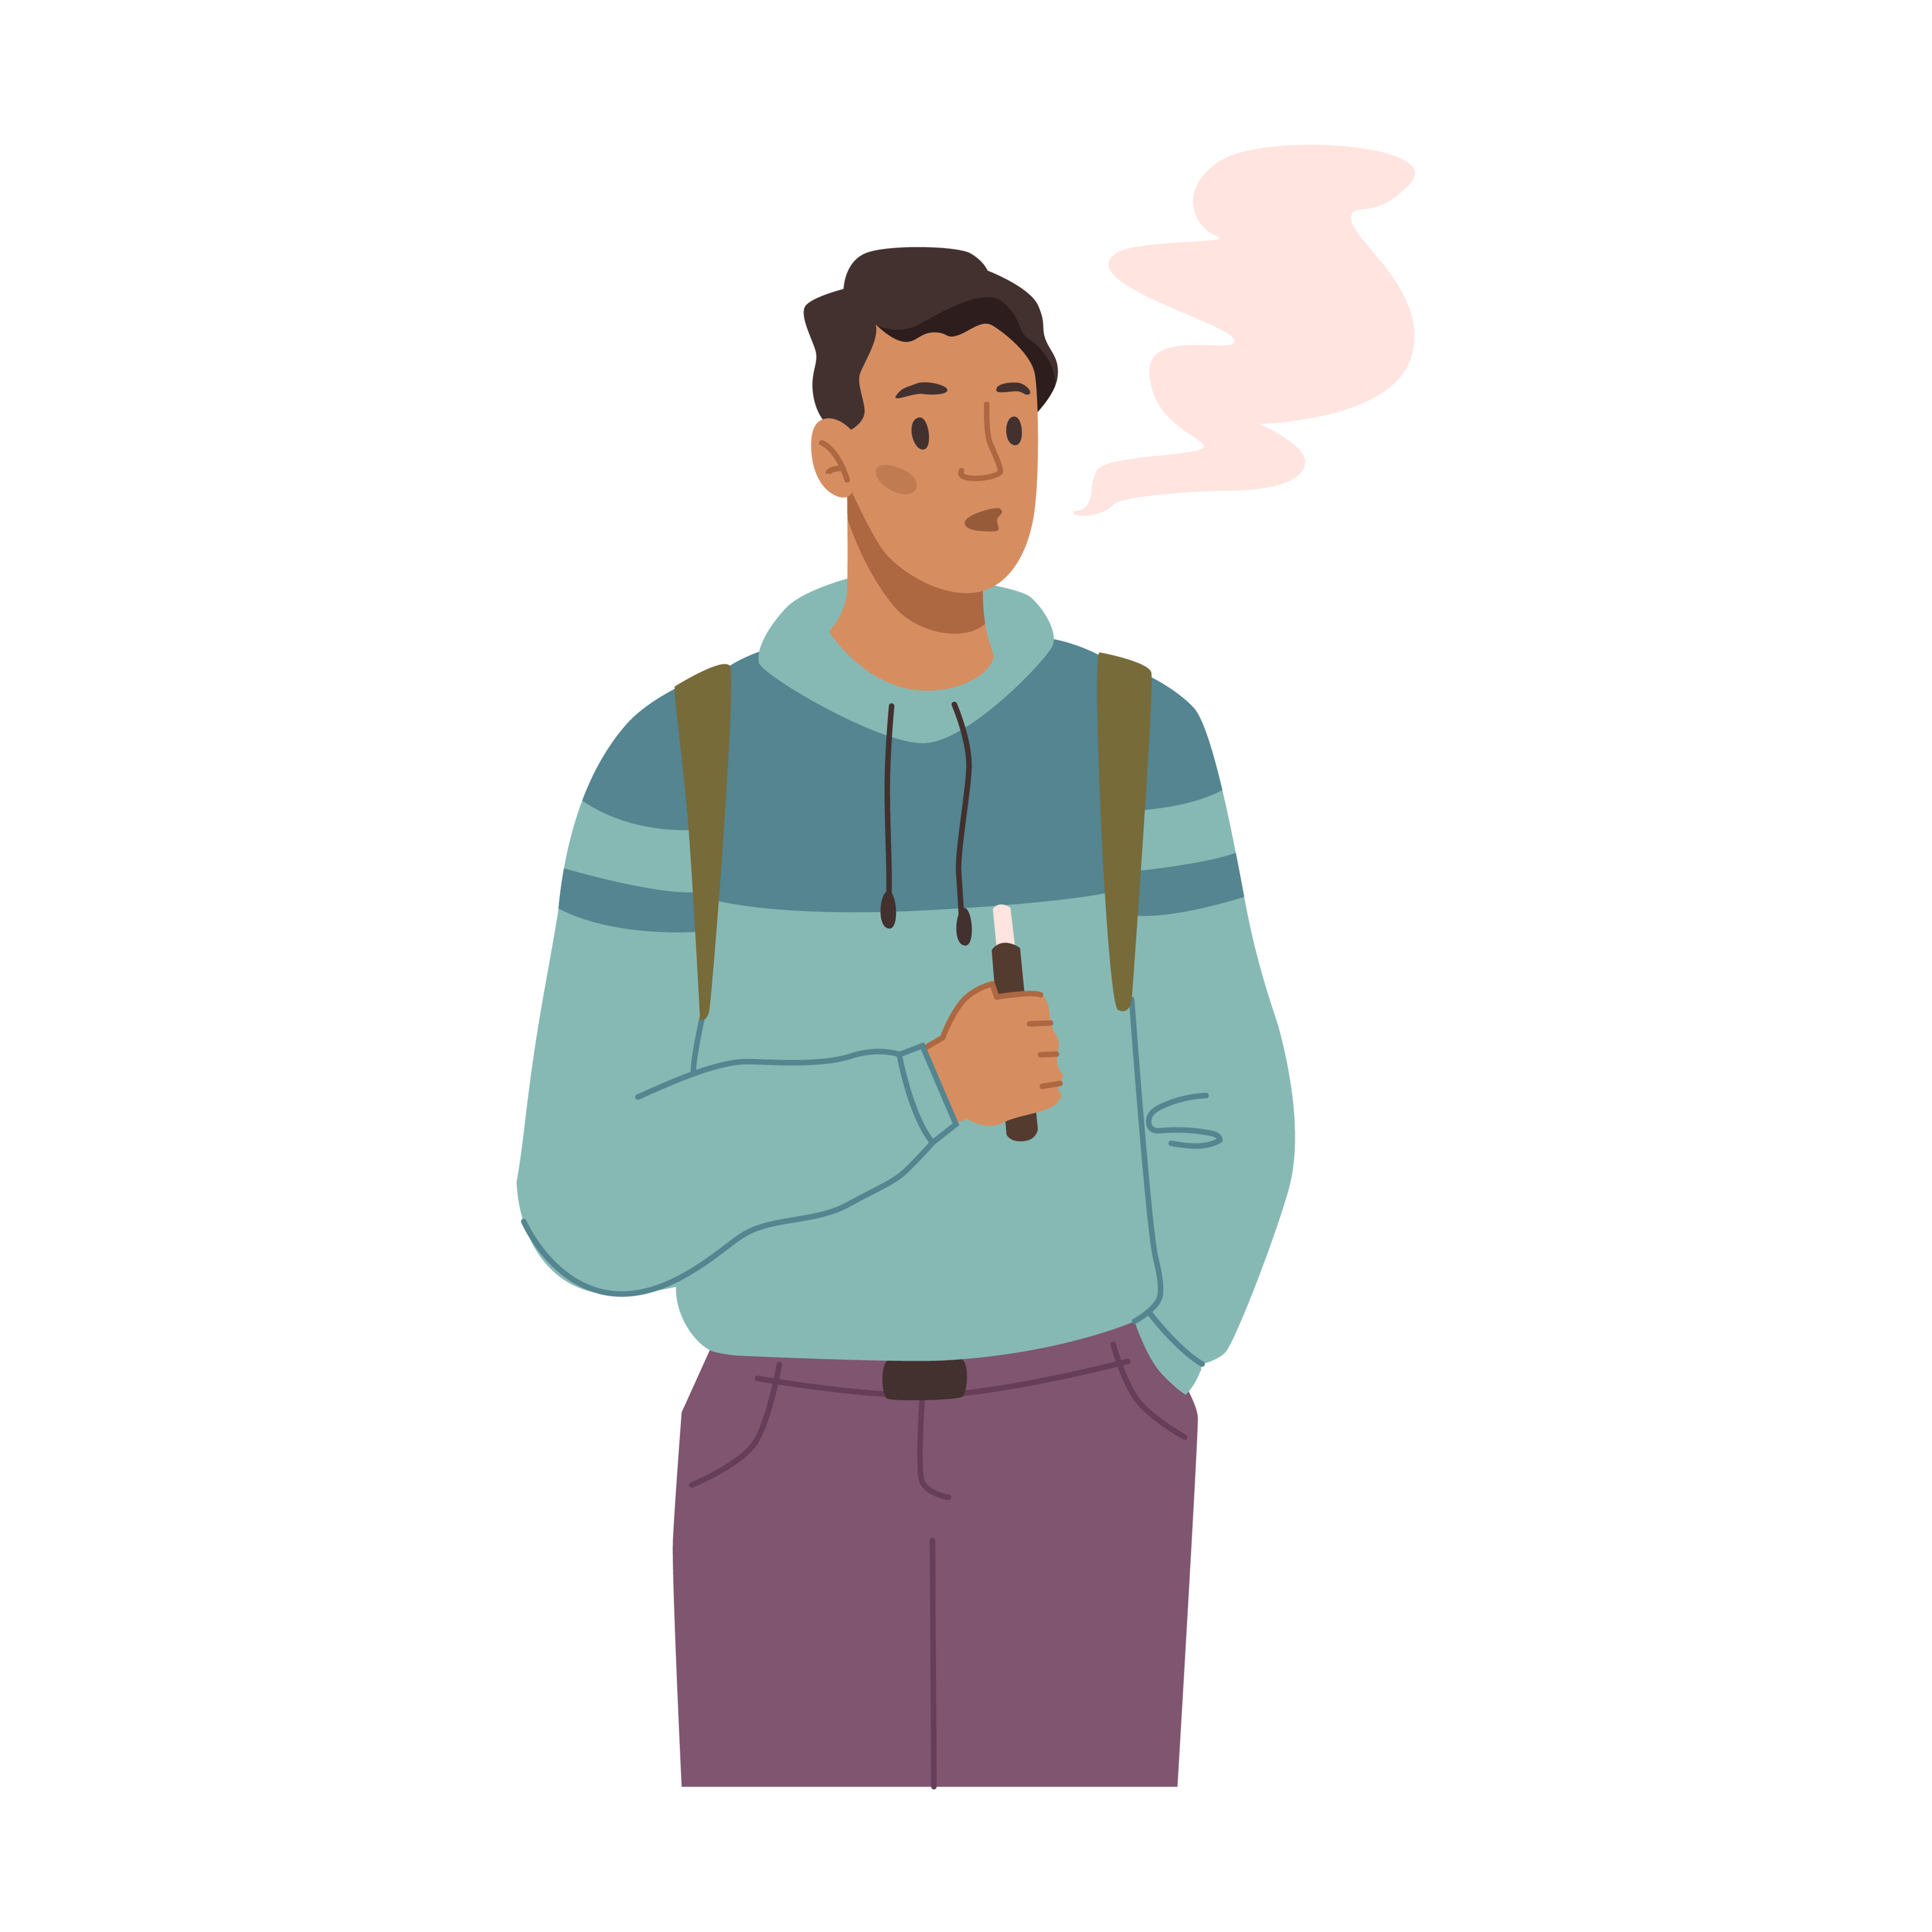
What about E-Cigarettes?
The increase in e-cigarette use, particularly among young people, is a dangerous trend with real health risks. For many reasons, e-cigarettes should not be promoted as a safe alternative to smoking. Here’s why:
IT’S STILL NICOTINE
Most e-cigarettes deliver nicotine – some types even have more nicotine than traditional cigarettes.
OTHER CHEMICALS
E-cigarette vapor includes potentially harmful substances, cancer-causing chemicals, volatile organic compounds, and heavy metals.
DANGEROUS LIQUID
Children and adults have been poisoned by swallowing, breathing, or absorbing
e-cigarette liquid through skin or eyes.
LUNG INJURIES
E-cigarettes have been linked to thousands of cases of serious lung injury, resulting in death.
Notes:
SOURCE
https://www.heart.org/en/healthy-living/healthy-lifestyle/quit-smoking-tobacco/is-vaping-safer-than-smoking

Slide 5

A Future Generation at Risk
The tobacco industry uses a variety of questionable tactics – including kid-friendly tobacco flavors, appealing packaging and social media marketing – to lure youth into a lifetime of addiction.
That’s why it’s so important to talk to kids at an early age about the dangers of tobacco/nicotine use!

Slide 6


How to Talk to Kids About Tobacco and Nicotine
Smoking can also harm our hearts! Our hearts are like superheroes that pump blood to all parts of our bodies. Smoking can damage our heart and blood vessels, making it harder for our heart to work properly.
Our lungs are like balloons that help us breathe. Smoking can make our lungs dirty and weaker. It can cause coughing, wheezing, and make it harder to breathe properly.
Smoking also doesn’t make us feel or look well. Smoking can turn our teeth yellow and give us bad breath. It can also make our clothes and hair smell unpleasant. It can make our taste buds less sensitive, so we might not enjoy food as much as we should. It can also make it harder for us to smell things.
Vaping isn’t good for us either! Vaping devices contain chemicals that can harm our bodies. These chemicals can cause damage to our lungs and other organs, even if they might taste or smell nice.
Notes:
SOURCE
https://www.heart.org/-/media/Healthy-Living-Files/LE8-Fact-Sheets/For-Kids/lifes_essential_8__for_kids_clear_the_air.pdf?sc_lang=en

Slide 7
How to Talk to Kids About Tobacco and Nicotine.
Smoking and vaping contains a substance called nicotine, which is very addictive. Once someone starts smoking, it can be very difficult to stop even though they know nicotine can hurt them. It’s best to stay away from smoking and not start this bad habit in the first place.
Sometimes friends might offer you a vape or cigarette. What might you say to them? You can say something as simple as, “No thanks, I want to stay healthy.” Friends should respect your choices. If you are stressed or feel pressure, you can always come to me.
Notes:
SOURCE
https://www.heart.org/-/media/Healthy-Living-Files/LE8-Fact-Sheets/For-Kids/lifes_essential_8__for_kids_clear_the_air.pdf?sc_lang=en

Slide 8
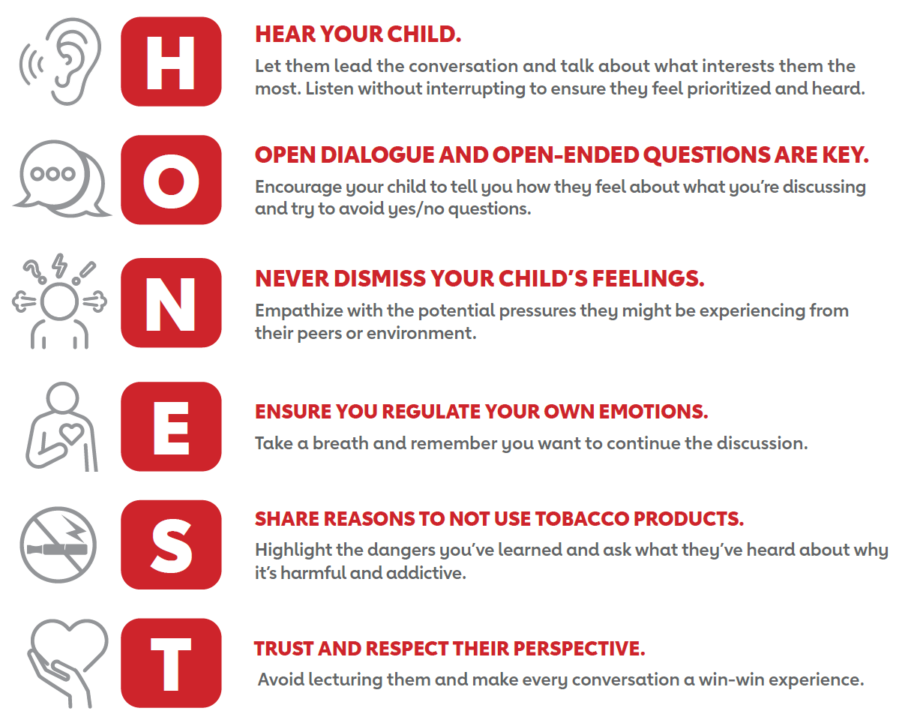
Talking to Middle and High Schoolers:
The HONEST Approach
Notes:
SOURCE
https://www2.heart.org/site/DocServer/Talking_to_your_child_about_tobacco_and_vaping.pdf

Slide 9

Smoking Affects Everyone
Smoking not only affects the person who smokes but also the people around them.
Breathing in secondhand smoke from someone else’s cigarette can be harmful.
Staying away from smoking and vaping is a great decision for our health and well-being. If you smoke, you can take steps to quit to protect both yourself and your family.
Notes:
SOURCE
https://www.heart.org/-/media/Healthy-Living-Files/LE8-Fact-Sheets/For-Kids/lifes_essential_8__for_kids_clear_the_air.pdf?sc_lang=en

Slide 10
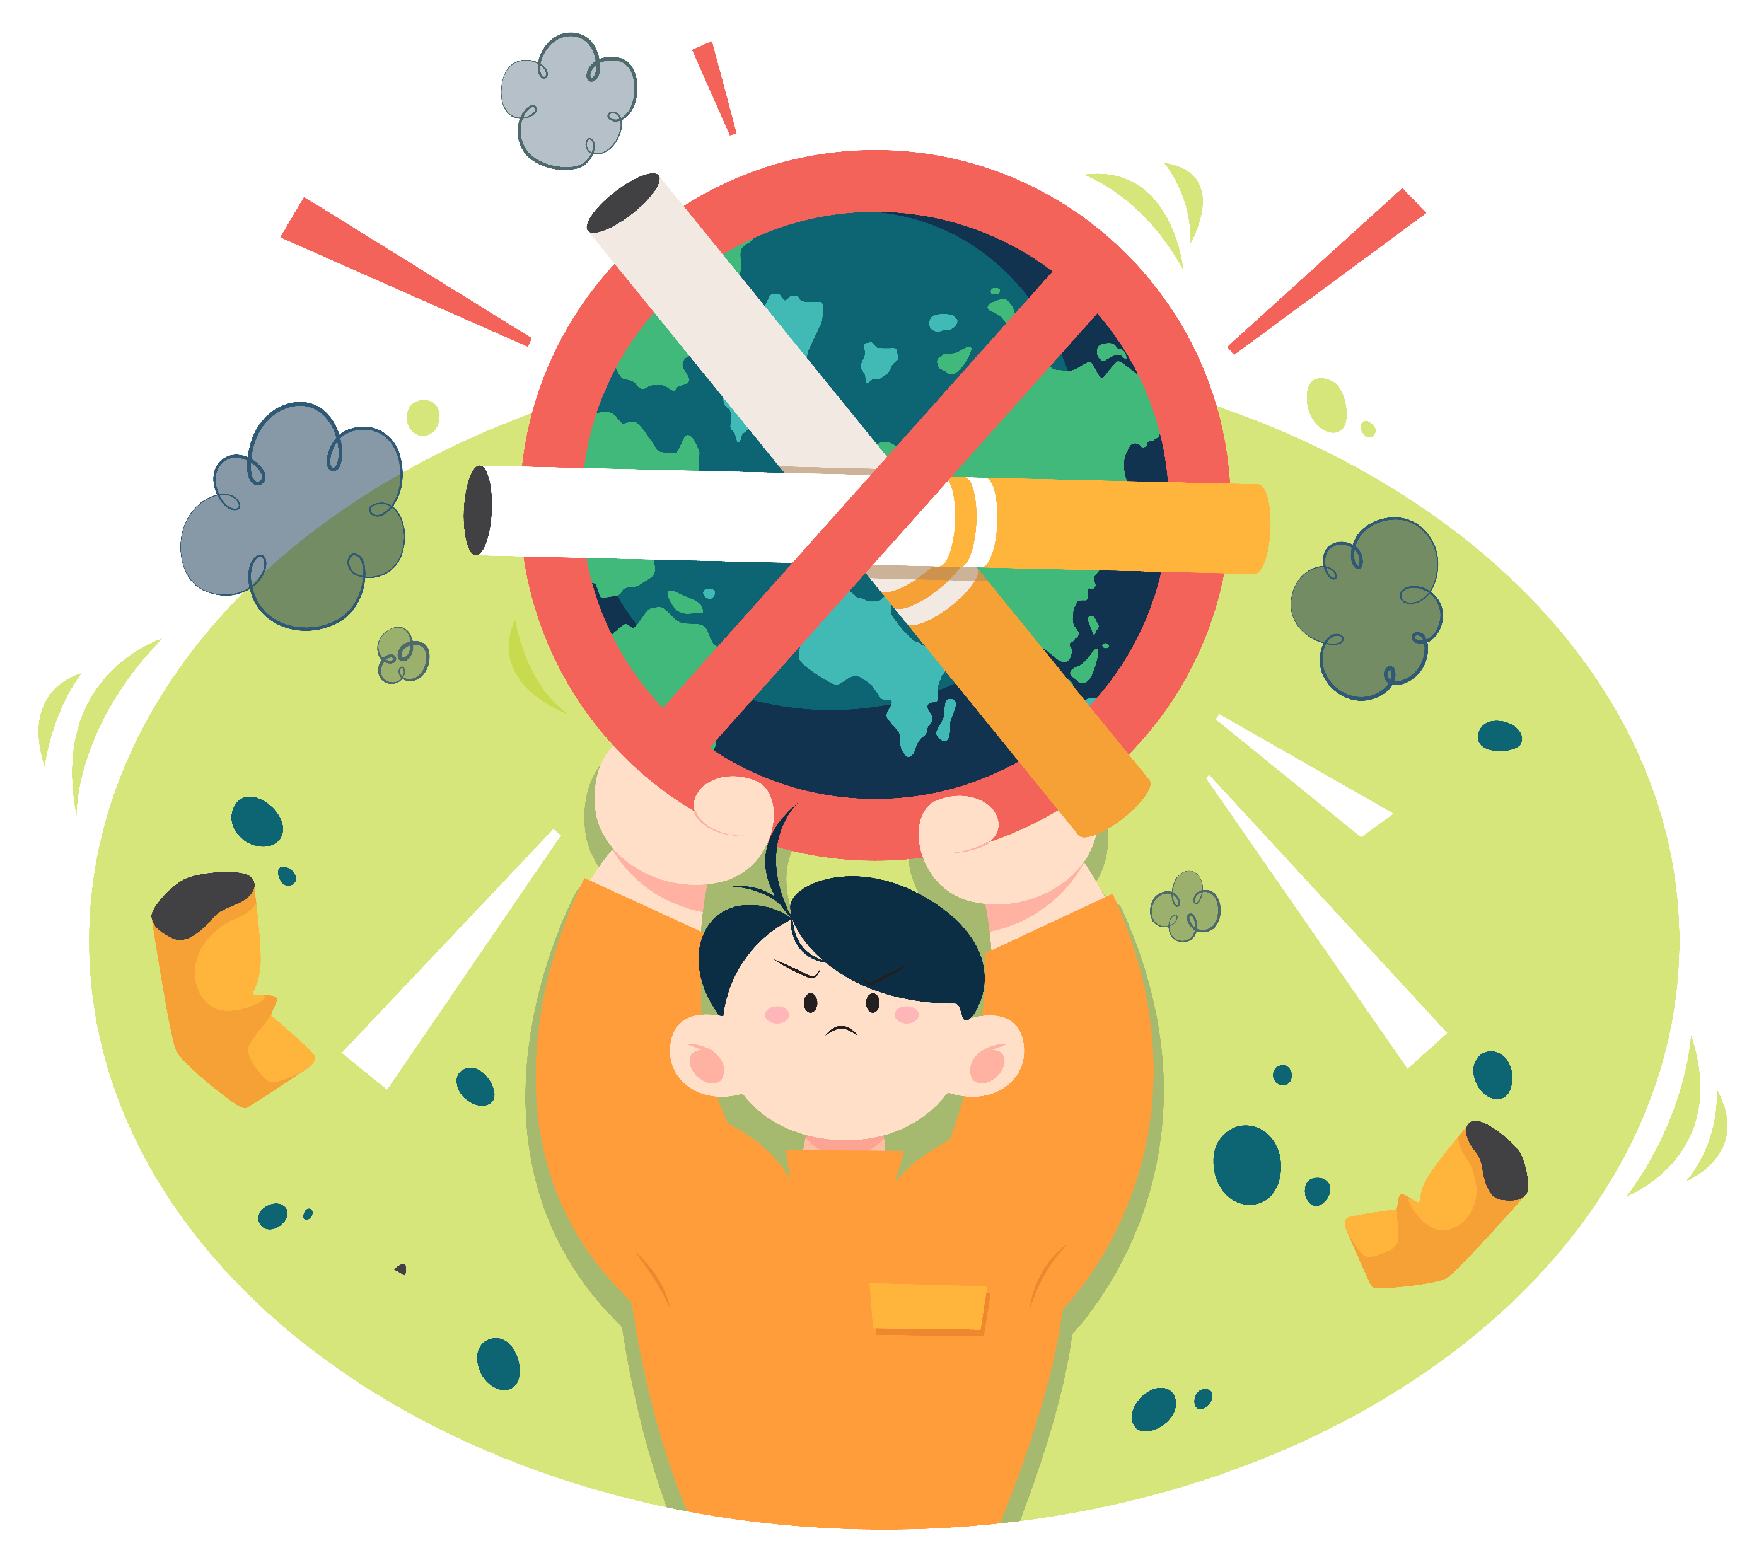
Make a Plan to Quit
You’re more likely to quit tobacco for good if you prepare.
Start by creating a plan that fits your lifestyle.
Set a quit date within the next 7 days. It’s best to pick a weekday that doesn’t look like it will be too stressful.
You can quit cold turkey or gradually. Decide if you need help from a health care professional, nicotine replacement or medicine.
Prepare for your quit day by planning how to deal with cravings and urges.
Quit on your
quit day!
SET A QUIT DATE
CHOOSE A METHOD
PREPARE
QUIT
Notes:
SOURCE
https://www.heart.org/en/healthy-living/healthy-lifestyle/lifes-essential-8/how-to-quit-tobacco-fact-sheet

Slide 11
Tips for Success
DEAL WITH URGES
Quitting is tough, and it’s normal to have cravings. When you feel the urge to smoke, vape or use nicotine, tell yourself to wait for
10-15 minutes – cravings can pass. Keep your hands and mouth busy. Try chewing gum, drinking water, or squeezing a stress ball.
LEARN YOUR TRIGGERS
Recognize what makes you want to smoke, vape or use nicotine. This can include things like stress, certain places, or social situations. Try to avoid or manage these triggers, especially at the beginning. Practice deep breathing exercises to help calm your body and mind.
GET SUPPORT
A buddy system or support program can help you with some of the common struggles of quitting. Call 1-800-QuitNow (784-8669), a free phone service that helps people quit smoking by connecting you to a counselor.
Notes:
SOURCE
https://www.heart.org/en/healthy-living/healthy-lifestyle/lifes-essential-8/how-to-quit-tobacco-fact-sheet

Slide 12
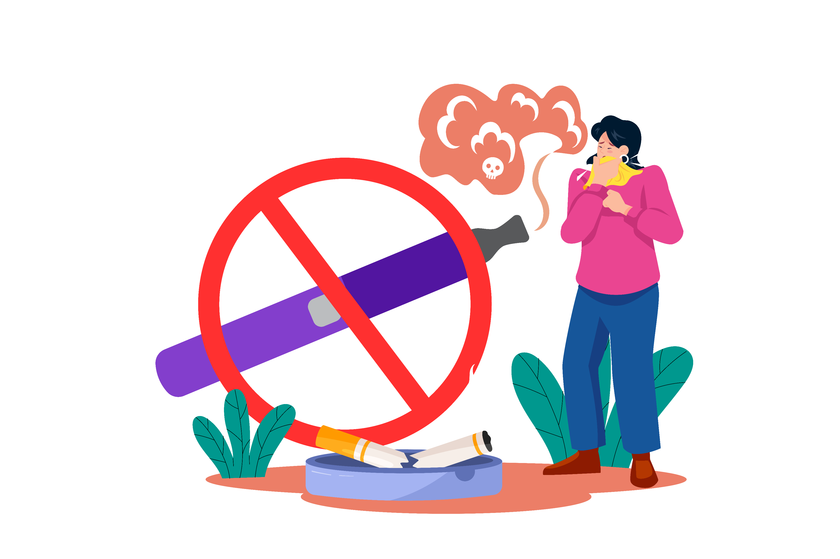
Wrap Up
Tobacco and nicotine use through smoking and vaping is dangerous and unhealthy – and increases our chances for cardiovascular disease.
Talk to your kids about smoking and vaping and encourage them to not start the habit – support them in quitting if they already have.
Quit yourself to protect yourself and your family. You can do it with a plan, preparation, and proper support.

